Slide 1
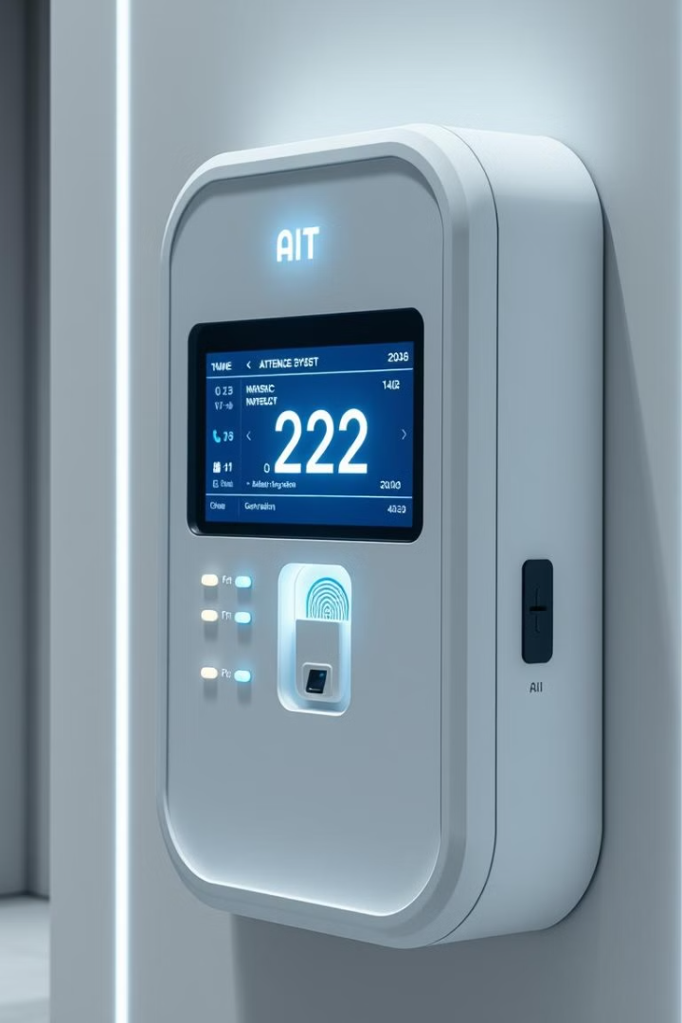
AI-Based Attendance System
This presentation will cover the development of an AI-based attendance system using Python, HTML, CSS, and JavaScript. It enhances accuracy and efficiency. Learn how to automate attendance tracking with facial recognition.
Presented by Your Name on Date.
by Gaurav Goswami
GG

Slide 2

Introduction
Attendance systems are crucial for accurate record-keeping in educational and professional settings. Traditional methods often lead to errors and proxy attendance issues. AI-based systems offer enhanced accuracy and efficiency.
Accuracy
Efficiency
Reduces errors.
Automates tracking.
Security
Prevents fraud.

Slide 3
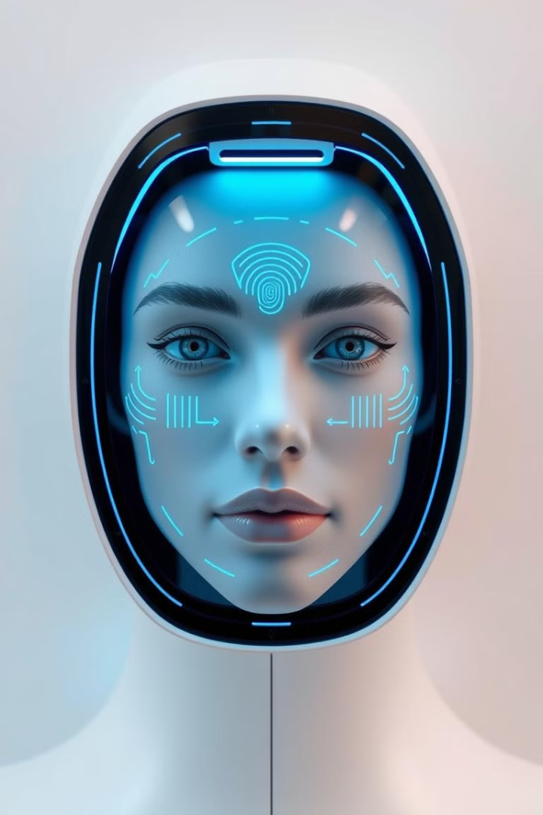
Objective
Our primary objective is to automate attendance tracking using advanced facial recognition technology. This system aims to reduce manual errors and eliminate proxy attendance. Ultimately improving efficiency and security.
Automation
Error Reduction
Automate attendance tracking with facial recognition.
Reduce manual errors and proxy attendance.
Efficiency
Improve efficiency and security in attendance management.

Slide 4




Scope of the Project
This system is applicable across various environments, including schools, colleges, and offices. It provides real-time attendance marking capabilities. Integration with databases and user authentication enhances scalability for large institutions.
Education
Corporate
Scalable

Slide 5




Technologies Used
The system leverages a combination of cutting-edge technologies. Python (OpenCV, TensorFlow/Keras, Flask) for the backend. HTML, CSS, and JavaScript for the frontend. MySQL/MongoDB for database management. Deep learning for AI and ML face recognition.
Python
Backend logic.
HTML/CSS/JS
Frontend UI.
MySQL/MongoDB
Data storage.

Slide 6



Methodology - Data Collection
Data collection involves capturing diverse facial images to create a comprehensive dataset. Images are preprocessed through grayscale conversion and normalization. Careful labeling of datasets is crucial for effective model training.
Process
2
Convert grayscale, normalize.
Capture
1
Collect images.
3
Label
Label datasets.

Slide 7



Methodology - Model Training
We employ Convolutional Neural Networks (CNN) for robust face recognition. Training is conducted using TensorFlow/Keras. Accuracy is rigorously tested. Model optimization ensures peak performance.
Optimization
1
Peak performance.
Testing
2
Accuracy validation.
Training
3
TensorFlow/Keras.

Slide 8
Methodology - System Integration
Integration is key to a functional system. A web-based UI allows easy user interaction. Database storage ensures secure attendance records. Flask API connects the AI model to the frontend for real-time processing.
Web UI
1
User interaction.
Database
2
Secure records.
Flask API
3
Connect AI model.

Slide 9
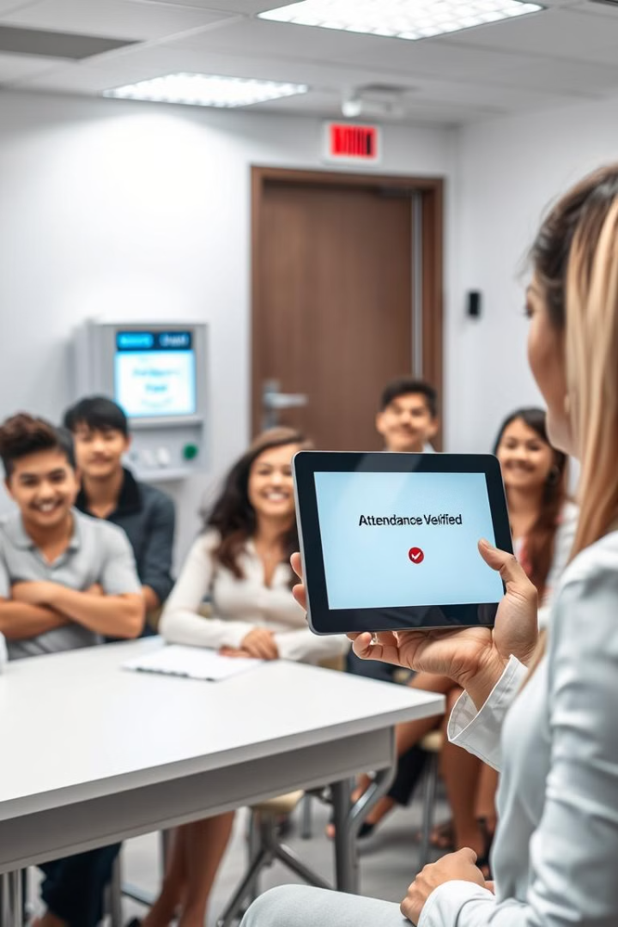
Expected Outcomes
The system promises automated and accurate attendance tracking. It reduces manual workload for educators and employers. The system is secure, reliable, and open to future enhancements such as voice recognition.
99%
75%
Accuracy Rate
Reduction in manual workload
24/7
System availability

Slide 10
Conclusion & Future Scope
This project demonstrates a robust AI-driven attendance system. Future enhancements include multi-factor authentication and mobile app integration. Encouraging AI-driven automation can transform institutional efficiency.
Summary
Future
AI-based attendance system overview.
Multi-factor authentication, mobile app.

